Slide 1

Team Bitlock

Slide 2


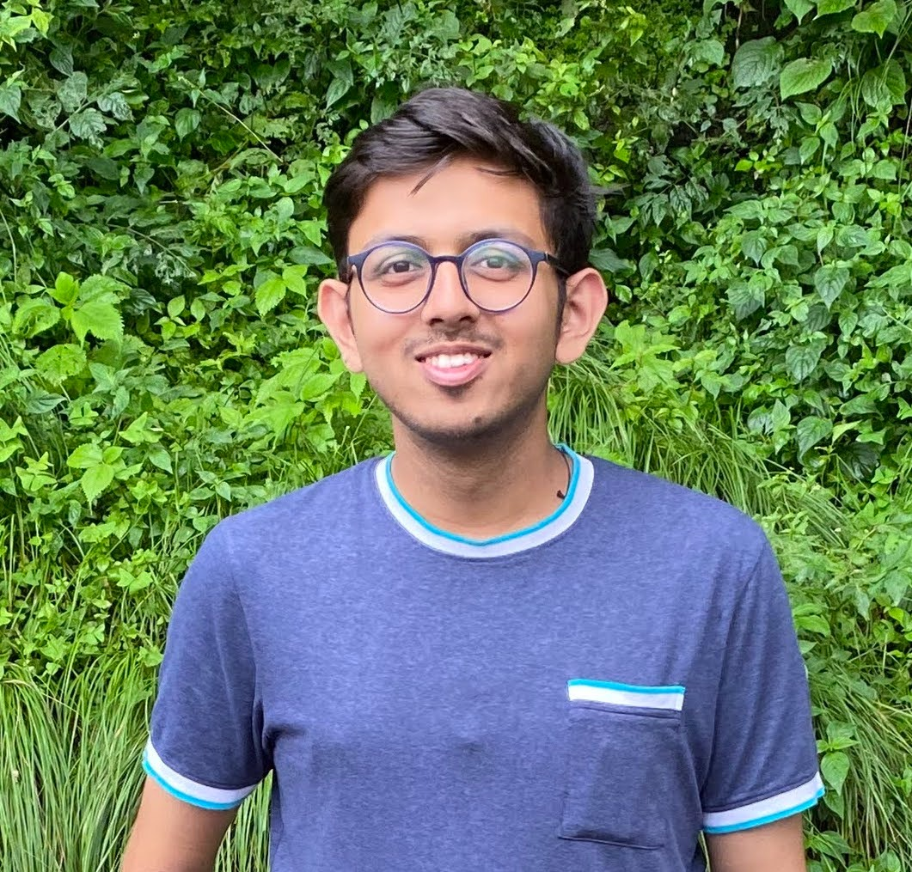

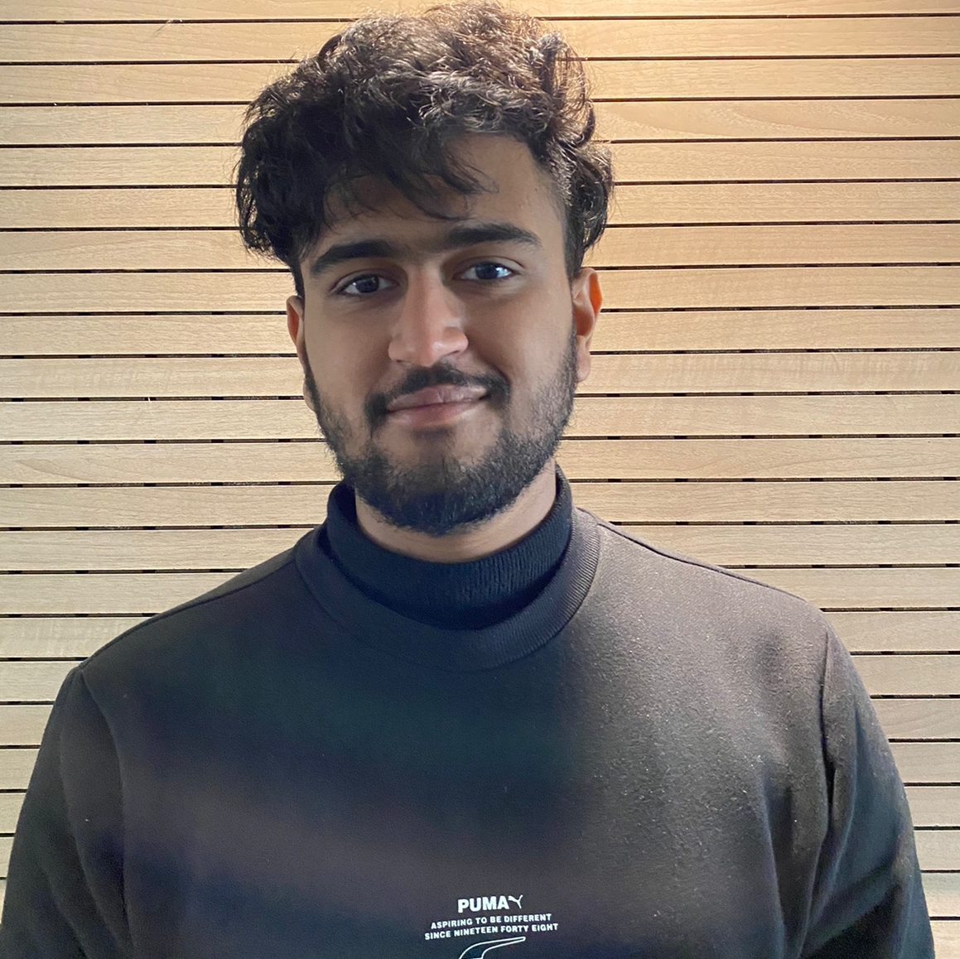
Team Presentation
Kartik Srivastava ML Developer
Thapar Institute of Engineering and Technology
Rudransh Bansal ML Developer
Thapar Institute of Engineering and Technology
Chayan Sinha Frontend Developer
Thapar Institute of Engineering and Technology
Arjun Dhawan Backend Developer
Thapar Institute of Engineering and Technology

Slide 3
Source Code Url
https://github.com/iamneo-production/92685f75-03e3-441a-b099-a6a541da9e7d
Our github link : https://github.com/arjundvn24/nasscom-temp/invitations

Slide 4

Model Evaluation Parameters
AQI Prediction Models:
ARIMAX: time-series forecasting model that incorporates autoregressive and moving average components with external predictors.
Prophet: time-series forecasting model developed by Facebook that can handle seasonality, trend changes, and outliers.
XGBoost: gradient boosting algorithm that can handle complex datasets with high-dimensional features.
Seasonal ETS: time-series forecasting model that can capture trend, seasonality, and irregularity in data.
XAI Techniques (SHAP and LIME): used for interpreting predictions made by machine learning models.
Heat Wave Prediction Models:
Prophet: time-series forecasting model that can handle seasonality, trend changes, and outliers.
Seasonal ETS: time-series forecasting model that can capture seasonal patterns in data.
SARIMAX: time-series forecasting model that incorporates external factors to improve accuracy of temperature forecast.
AQI Prediction
Models used for Predicting AQI- SARIMAX , XGBOOST , PROPHET, SEASONAL ETS ,XAI - SHAP , LIME
Heat Wave Prediction
Models Used - PROPHET , SARIMAX , SEASONAL ETS
Data Collection
And Models Used
Data collection For
AQI and Heat Wave
Prediction
Through Open Source Data
And API calls

Slide 5
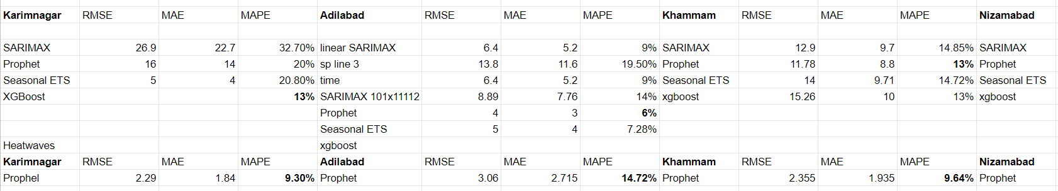
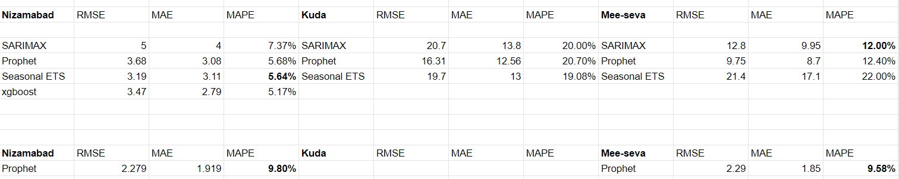
MODEL EVALUATION PARAMETERS

Slide 6
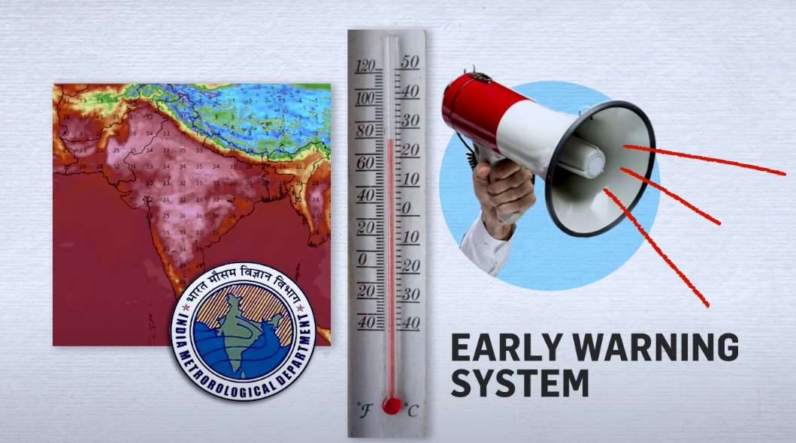
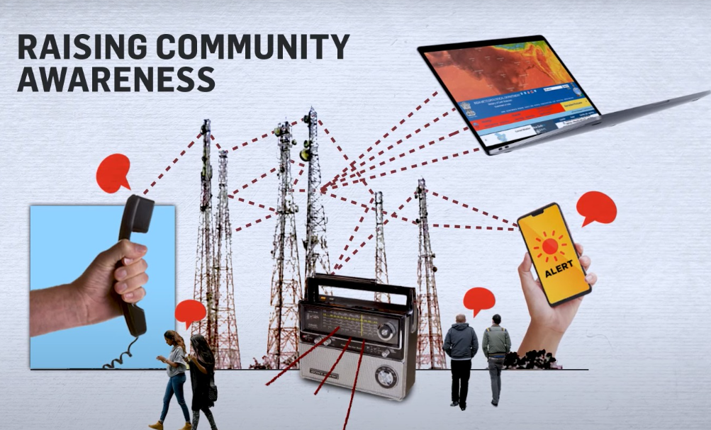
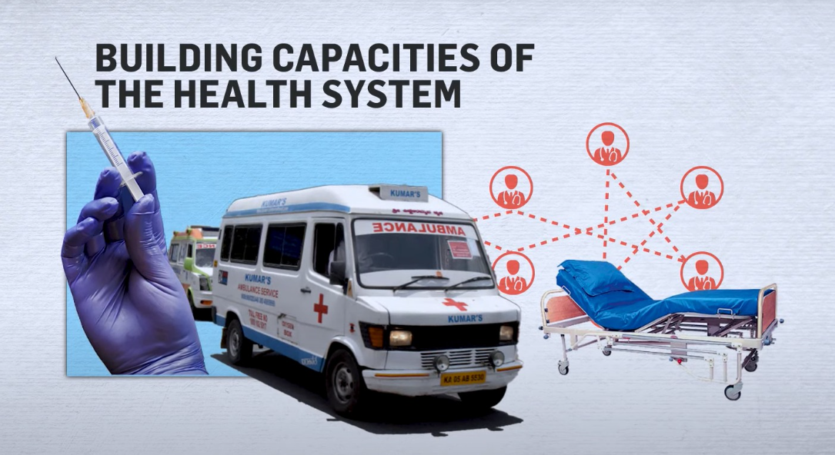
OUR STARTUP PLAN
Our startup is focused on improving public health and safety by developing an early warning system for potential health hazards, raising awareness about the importance of preventive healthcare measures, and building the capacity of healthcare systems to respond effectively to public health emergencies.

Slide 7
PROBLEM STATEMENT
OUR SOLUTION
An AQI and heatwave predictor is essential as people are losing their lives due to extreme heat and poor air quality, mainly due to a lack of awareness. Building a predictor can alert individuals to the potential risks and enable them to take preventive measures to protect themselves. In addition, such predictors can inform policymakers and support efforts to reduce pollution and mitigate the impacts of climate change.
Our startup is focused on creating an affordable device that measures vital signs in areas with severe air pollution and heatwaves, enabling early detection and prevention of health issues, particularly for vulnerable populations. We are also developing an alarming system that provides real-time information on environmental conditions, helping people to take necessary precautions and seek medical assistance if required, ultimately enhancing public health in these areas.

Slide 8
HELP WE NEED FOR START UP :
Mentoring: Guiding and supporting someone as they start a tech business.
Networking: Introducing them to potential investors, partners, and customers.
Funding: Investing in or connecting them with investors for necessary funding.
Expertise: Offering skills or knowledge to help with marketing, product development, software engineering, or other aspects of technology.
Feedback: Providing constructive feedback on their business plan, pitch, product, or technology implementation
UTILIZATION OF PRIZE MONEY:
Expand early warning system to cover more areas and improve accuracy.
Launch more extensive health awareness campaigns targeting different demographics.
Provide training, equipment, and resources to improve healthcare provider's response to emergencies.
Hire additional team members with specialized skills.
Conduct research and development activities to refine technology and methodologies.
Establish partnerships with other organizations to expand capabilities and reach.

